Slide 1
Information Retrieval
Topic- Relevance feedback and query expansion
(Relevance feedback contd…)
Lecture-30
Prepared By
Dr. Rasmita Rautray & Dr. Rasmita Dash
Associate Professor
Dept. of CSE

Slide 2
Relevance feedback

Slide 3
Content
Relevance feedback
Rocchio algorithm
Relevance feedback: Assumptions
Relevance feedback: Evaluation

Slide 4
Relevance
A document is relevant if it gives the user the information she was looking for.
To evaluate relevance, we need an evaluation benchmark with three elements:
A benchmark document collection
A benchmark suite of queries
An assessment of the relevance of each query-document pair

Slide 5
Interactive relevance feedback: improve initial retrieval results by telling the IR system which docs are relevant / non-relevant.
Best known relevance feedback method: Rocchio feedback
Query expansion: improve retrieval results by adding synonyms / related terms to the query
Sources for related terms: Manual thesauri, automatic thesauri, query logs

Slide 6
Options for improving recall
Local: Do a “local”, on-demand analysis for a user query
Main local method: relevance feedback
Global: Do a global analysis once (e.g., of collection) to produce thesaurus
Use thesaurus for query expansion

Slide 7
Relevance feedback: Basic idea
The user issues a (short, simple) query.
The search engine returns a set of documents.
User marks some docs as relevant, some as non-relevant.
Search engine computes a new representation of the information need. Hope: better than the initial query.
Search engine runs new query and returns new results.
New results have (hopefully) better recall.
We will use the term ad hoc retrieval to refer to regular retrieval without relevance feedback.

Slide 8
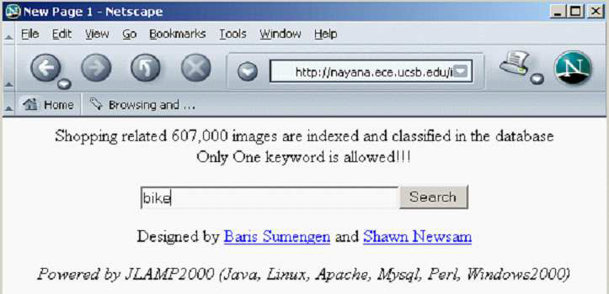
Relevance feedback: Examples

Slide 9
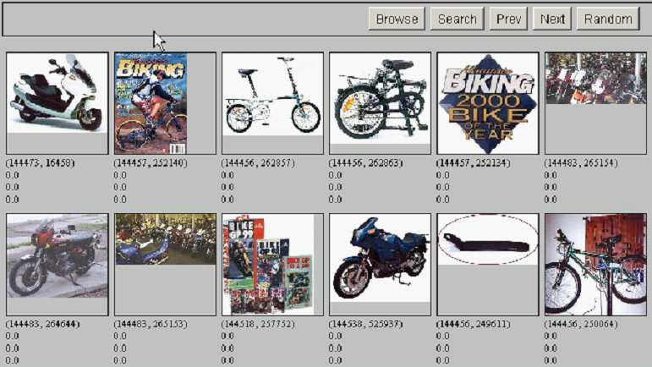
Results for initial query

Slide 10
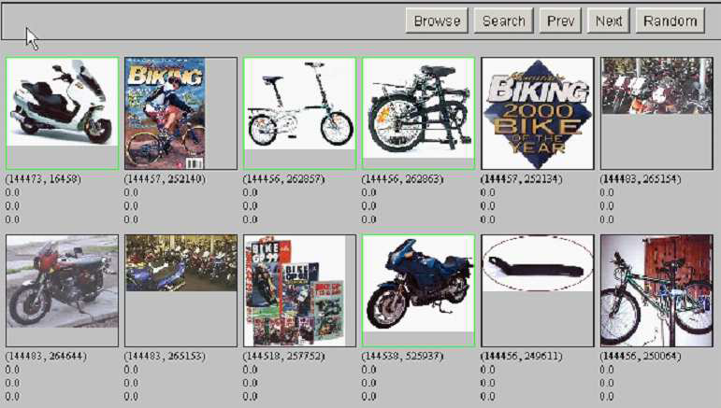
User feedback: Select what is relevant

Slide 11
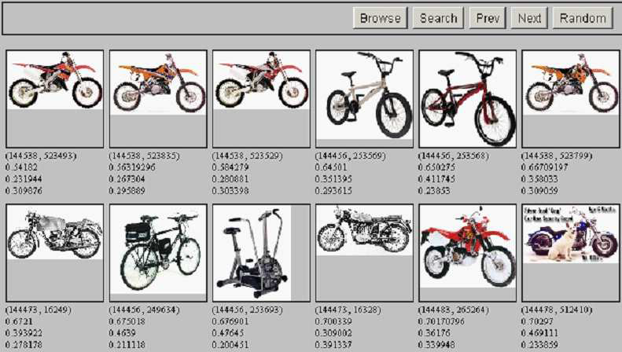
Results after relevance feedback

Slide 12
Key concept for relevance feedback: Centroid
The centroid is the center of mass of a set of points.
Recall that we represent documents as points in a high-dimensional space.
Thus: we can compute centroids of documents.
Definition:
where D is a set of documents and is the vector we use to represent document d.

Slide 13
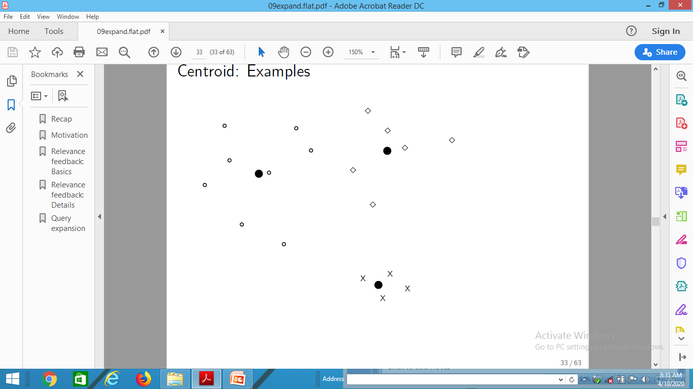
Centroid: Examples

Slide 14
Rocchio algorithm
The Rocchio algorithm implements relevance feedback in the vector space model.
Rocchio chooses the query that maximizes
D_{r} : set of relevant docs; D_{nr} : set of nonrelevant docs
Intent: is the vector that separates relevant and non-relevant docs maximally.
Making some additional assumptions, we can rewrite as:

Slide 15
Rocchio algorithm
The optimal query vector is:
We move the centroid of the relevant documents by the difference between the two centroids.

Slide 16
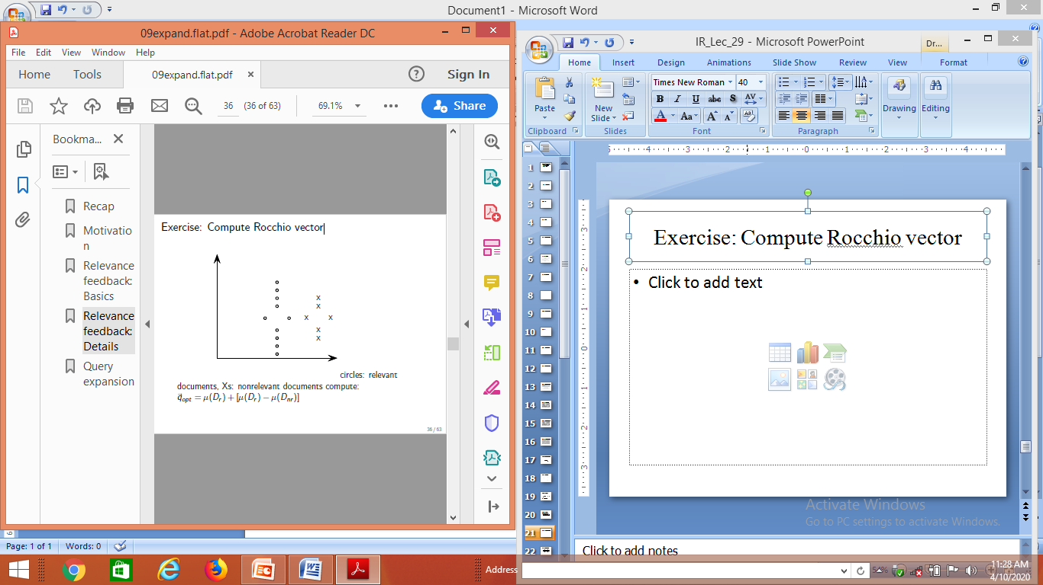
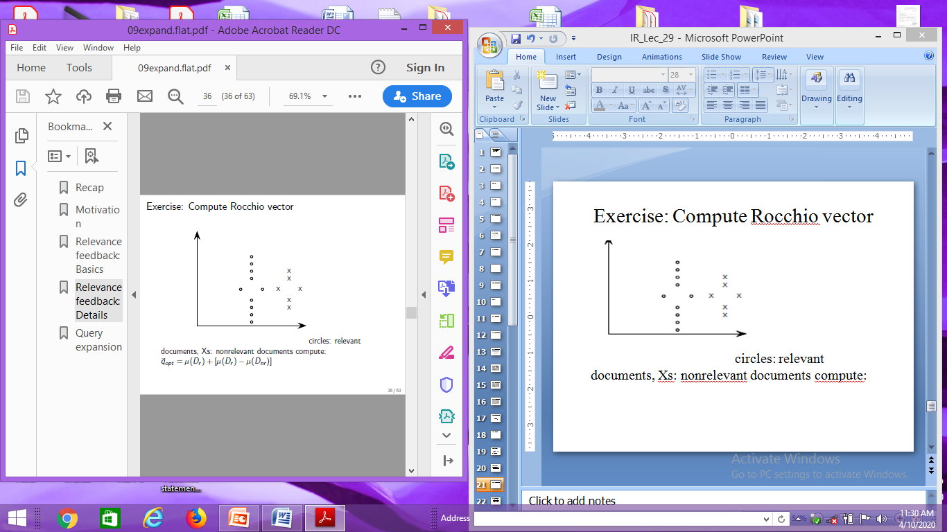
Exercise: Compute Rocchio vector
circles: relevant documents,
Xs: nonrelevant documents
compute:

Slide 17
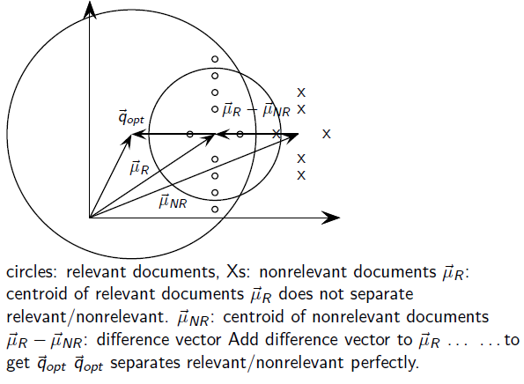
Rocchio illustrated

Slide 18
Positive vs. negative relevance feedback
Positive feedback is more valuable than negative feedback.
For example, set β = 0.75, γ = 0.25 to give higher weight to positive feedback.
Many systems only allow positive feedback.

Slide 19
Relevance feedback: Assumptions
When can relevance feedback enhance recall?
Assumption A1: The user knows the terms in the collection well enough for an initial query.
Assumption A2: Relevant documents contain similar terms

Slide 20
Violation of A1
Assumption A1: The user knows the terms in the collection well enough for an initial query.
Violation: Mismatch of searcher’s vocabulary and collection vocabulary
Example: cosmonaut / astronaut

Slide 21
Violation of A2
Assumption A2: Relevant documents are similar.
Example for violation: [contradictory government policies]
Several unrelated “prototypes”
Subsidies for tobacco farmers vs. anti-smoking campaigns
Aid for developing countries vs. high tariffs on imports from developing countries
Relevance feedback on tobacco docs will not help with finding docs on developing countries.

Slide 22
Relevance feedback: Assumptions
When can relevance feedback enhance recall?
Assumption A1: The user knows the terms in the collection well enough for an initial query.
Assumption A2: Relevant documents contain similar terms (so I can “hop” from one relevant document to a different one when giving relevance feedback).

Slide 23
Relevance feedback: Evaluation
Pick an evaluation measure, e.g., precision in top 10: P@10
Compute P@10 for original query q₀
Compute P@10 for modified relevance feedback query q₁
In most cases: q₁ is spectacularly better than q₀!
Is this a fair evaluation?

Slide 24
Relevance feedback: Evaluation
Fair evaluation must be on “residual” collection: docs not yet judged by user.
Studies have shown that relevance feedback is successful when evaluated this way.
Empirically, one round of relevance feedback is often very useful. Two rounds are marginally useful.

Slide 25
Evaluation: Caveat
True evaluation of usefulness must compare to other methods taking the same amount of time.
Alternative to relevance feedback: User revises and resubmits query.
Users may prefer revision/resubmission to having to judge relevance of documents.
There is no clear evidence that relevance feedback is the “best use” of the user’s time.

Slide 26
Relevance feedback: Problems
Relevance feedback is expensive.
Relevance feedback creates long modified queries.
Long queries are expensive to process.
Users are reluctant to provide explicit feedback.
It’s often hard to understand why a particular document was retrieved after applying relevance feedback.
The search engine Excite had full relevance feedback at one point, but abandoned it later.

Slide 27
Pseudo-relevance feedback
Pseudo-relevance feedback automates the “manual” part of true relevance feedback.
Pseudo-relevance feedback algorithm:
Retrieve a ranked list of hits for the user’s query
Assume that the top k documents are relevant.
Do relevance feedback (e.g., Rocchio)
Works very well on average
But can go horribly wrong for some queries.
Because of query drift
If you do several iterations of pseudo-relevance feedback, then you will get query drift for a large proportion of queries.

Slide 28
Thank You

